Slide 1





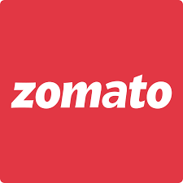
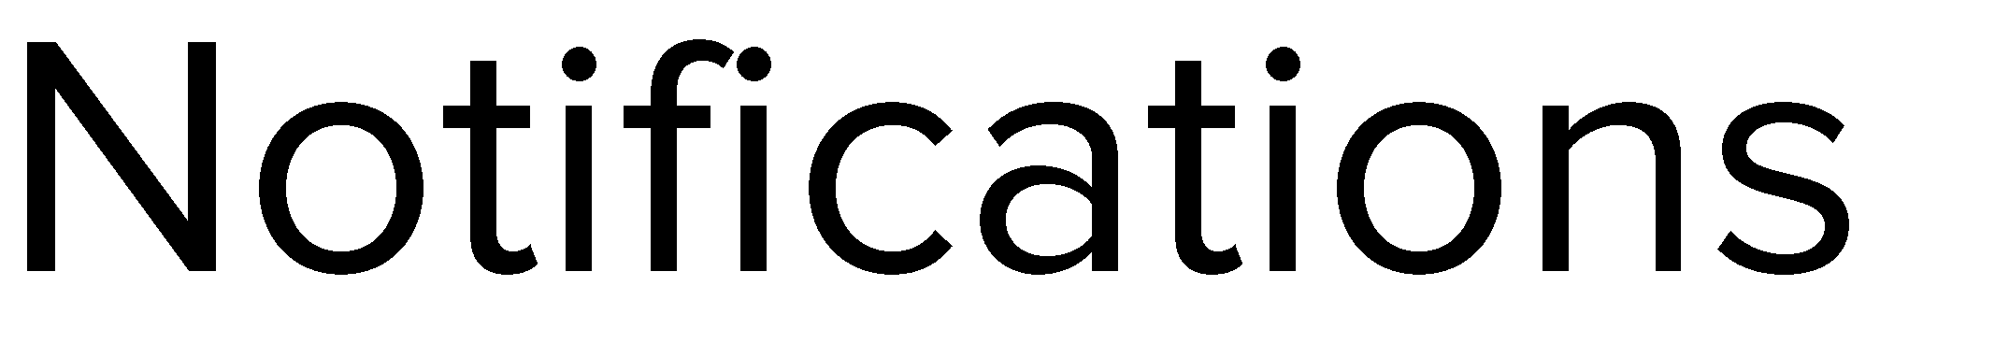
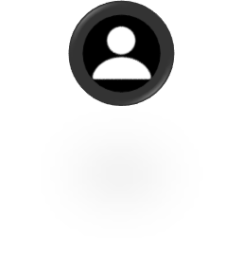
Mayank Kumar

Slide 2


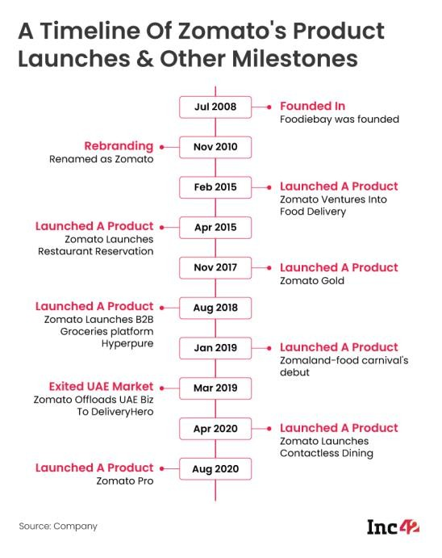
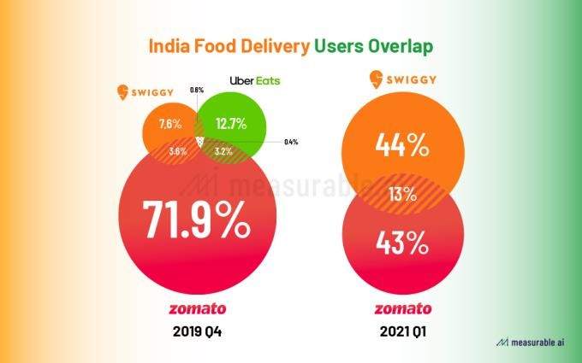
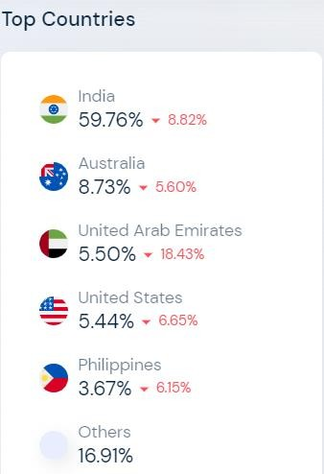
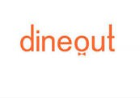


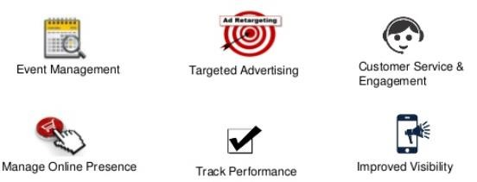


Zomato is an Indian multinational restaurant aggregator and food delivery company. it was founded back in 2008. Currently headquartered in Gurgaon, Haryana, it is spread over 24 different countries and 10k + cities. (2019)
It really has come a long way since 2008 introducing some interesting new products that
always helps bring a delight to the user’s mouth.
Market Capture:
Starting its international expansion back in 2012 into several countries including UAE, UK, Philippines , South Africa etc. and in 2015, acquired Urbanspoon, making its entry into USA & Australia.
Mission: “Better food for more people.”
Competitors:
Zomato’s Value Proposition:

Slide 3



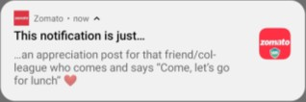
Rahul
24, Working Professional Gurgaon, India
Order Tracking
Zomato sends these notifications when we have placed an order. As part of order progress update.
User Behaviour
These notifications are sent based on user behaviour. Basically, these are sent keeping in mind content of last order, order time etc. Hence it is user specific.
Description:
He works as a Data Scientist at a tech company so is very tech savvy. Being busy, has no time to cook. Needs to orders meals almost everyday. Likes to maintain his physique but also satisfies occasional cravings. Finds physically buying takeouts to be a hassle & time consuming.
Offers
Zomato sends notifications with some relevant offers. For eg, if user pattern indicates he likes coffee, lets send him a coupon code around snacks time.
Mealtime
To increase conversion rate, Zomato sends lucrative notifications right before the local average mealtimes.
Pain Points:
Delivery Speed. Also, spends time deciding what to
eat.
Healthy, warm & nutritious food at the end of day not readily available, unable to cook.
Needs a tool to recommend new food cuisines and places to satisfy cravings.
Occasions
On occasions and festivals, Zomato sends wishes and with right timing, users tend to order more, be it sweets for guests to meals because they feel like celebrating.
Items in Cart
Notifications are sent when the user has added items in his cart and dropped off. Just in case he got preoccupied & forgot to complete his order.

Slide 4


Pre Order Notification
In-App Notification
Post order Notification
Search
Order
Read Notification Tap on Notification | Search menu if notification hits sweet spot Look at offers | User orders food | To prompt coupon has been applied Order & Payment status updates | ETA & order status. Contact delivery partner
Tap on Notification Collapse Notification | Launches app Searches food items | UJ from Add to cart to payment. | Tap the prompt or go to orders tab to track order. | Checks notifications for order updates Contact support in case of trouble
Loved Notification:😋 Found it to be spam:🙄 | ☺️ | Order from 1+ outlets:😕 Order from 1 outlet: ☺️ | ☺️ | Successful order:😁🍴 Order delayed & unnotified:😠
People find repeated irrelevant notifications to be spam | High surge fee Too many choices Cannot see which restaurants a coupon applies | Have to order separately for each outlet. | No notification prompting to list of available coupons. | Notification not updated in case of delays.
User customisation - if he repeatedly swipes then don’t send. Prompt user to opt in/out in first visit. | Send notification when surge fee is low | Allow ‘Add to Cart’ ordering from multiple outlets in single order. | There should be this prompt to ensure user doesn’t miss it. | Should notify user in case of delay with reason and revised ETA.
Goal
Action
Feeling
Pain Points
Solutions

Slide 5

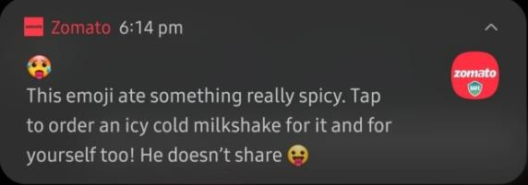
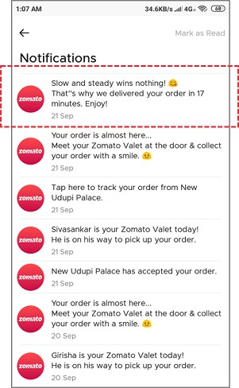
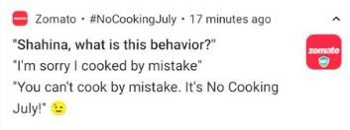
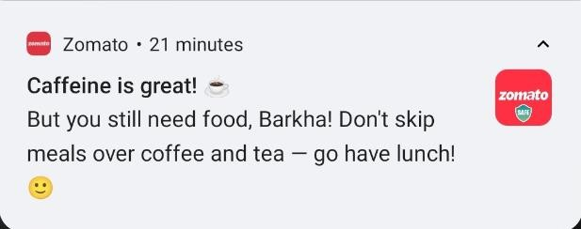
Order update Notification Users wont feel the
need to check the app and follow up regularly, they wont feel ghosted if these notifications are delivered to them. If the major updates like ‘order picked up’ or ‘on the way’ are given to the user, then it decreases user effort for follow- up. This dramatically increases the value user feels and increases retention.
Relatable, engaging witty content
The witty content is a great marketing strategy as this will stand out as compared to the regular notifications and will increase the CTR. It might play on various psychological factors, give user validation at the right time ultimately giving them the little push they need to place the order.
Notification Timing
The timing of the notification is really crucial. Zomato takes care to delivery notification about relatable type of food at the right time.

Slide 6
North Star Metric: Notification Click through Rate
CTR = # Users tapped on notification / total # users notification was sent to
Conversion rate: # users transacting / # users who
received the notification.
ARPU = revenue generated per week / no of active
transacting users.
Retention = (#Cx at end of month - #Cx acquired during month) / # Cx at start of month.
Frequency & Timing of Notifications – This is measured through monitoring CTR across time intervals.
Engagement rate: Time spent on the app per day
Uninstall rate = # uninstalls / # notifications
sent

